Slide 1
Applied Data Science 2
Dr Ashley SpindLer
Semester B, 2022

Slide 2
Lecture 8 - Outcomes
Dive deeper into the inner workings of TensorFlow with custom models and layers
Explore the design of “Variational Autoencoders” and generative neural networks

Slide 3
Customising Models and Layers
progressive disclosure of complexity

Slide 4
Layers and Models are Abstractions
The Layer and Model classes in Keras take the mathematical underpinnings of neural networks—the weights, the computations, the backpropagation, etc—and wrap them up in a simplified package.

Slide 5
Custom Layers - Subclassing

Slide 6
Custom Layers - Subclassing
from tensorflow.keras import layers
class MyLayer(layers.Layer):
# By including the Layer class in
# the brackets, we inherit its
# properties

Slide 7
Core Elements of a Layer
class MyLayer(layers.Layer):
def __init__(self, *args):
# Runs when the class is called
super(MyLayer, self).__init__()
# Runs the __init__() method of
# the parent class

Slide 8
Core Elements of a Layer
Refers to the Layer’s properties and methods:
self.weights, self.call()
class MyLayer(layers.Layer):
def __init__(self, *args):
# Runs when the class is called
super(MyLayer, self).__init__()
# Runs the __init__() method of
# the parent class

Slide 9
Core Elements of a Layer
class Linear(layers.Layer):
def __init__(self, units):
super(Linear, self).__init__()
self.units = units
# set up initial properties in
# the __init__() method

Slide 10
Core Elements of a Layer
Layer weights often depend on the input shape, which might be unknown when you call __init__()
class MyLayer(layers.Layer):
def build(self, input_shape):
# build is called automatically
# when the layer is first used
# in a model

Slide 11
Core Elements of a Layer
class Linear(layers.Layer):
def build(self, input_shape):
# Use build to set up layer weights self.w = self.add_weight(
shape=(input_shape[-1],
self.units),
initializer=‘random_normal’,
trainable=True)

Slide 12
Core Elements of a Layer
class Linear(layers.Layer):
def build(self, input_shape):
# Use build to set up layer weights self.w = self.add_weight(
shape=(input_shape[-1],
self.units),
initializer=‘random_normal’,
trainable=True)

Slide 13
Core Elements of a Layer
class MyLayer(layers.Layer):
def call(self, inputs):
# here is where the computation
# takes place

Slide 14
Core Elements of a Layer
class Linear(layers.Layer):
def call(self, inputs):
x = tf.matmul(inputs, self.w)
x = x + self.b
return x

Slide 15
Model Class
Subclassing Model works the same as Layer, but importantly:
It allows the use of .fit, .evaluate, .predict
It exposes the list of inner layers, via model.layers
It allows saving of the model and weights, .save(), .save_weights()

Slide 16
When to use Model or Layer?
Layer
Model
Used for individual computations (such as a convolutional layer) or blocks of computations (a “ResNet Block”)
Anything that is going to be used repeatedly inside a bigger model
Anything that does not need to use built-in training or saving methods
A collection of layers comprising a “deep learning model” or “network”.
Will contain multiple layers and blocks.
Anything that you need to call .fit() or .save().
You can have multiple sub-models—such as the encoder and decoder—inside a parent model.

Slide 17
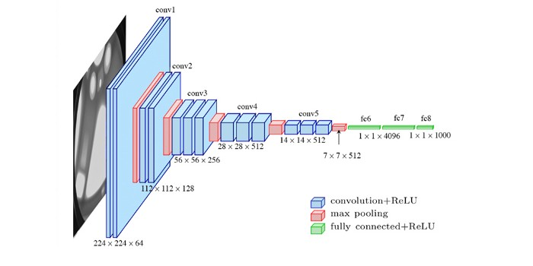
Demo – VGGNet Convolutional Block
The architecture of VGG16 — uploaded by Max Ferguson in ResearchGate

Slide 18
Demo – VGGNet Convolutional Block
Convolution
Kernel 3x3
Strides 1
Convolution
Kernel 3x3
Strides 1
Dropout
Max Pooling

Slide 19
Live Demo: A custom model

Slide 20
Regularisation

Slide 21
Generalisation
The central challenge of machine learning is to produce a model that must perform well on new, unseen inputs. This is called generalisation.
When consider a models ability to generalise, we need to consider the training error and the generalisation or test error.

Slide 22
Underfitting and Overfitting
The two main factors we consider in a machine learning model are:
Its ability to make the training error small
Its ability to make the gap between the training and test error small
Underfitting occurs when the training error cannot be made sufficiently small, while overfitting occurs when the gap between the train and test error is too large.

Slide 23
Model Capacity
We can consider over and underfitting as related to a model’s capacity—informally, its ability to fit a wide variety of functions.
With low capacity, a model will struggle to find solutions for the training set, but with high capacity it will overfit by memorising properties of the training data that aren’t useful for the test set.

Slide 24
Functions in Models
In some cases we can change the functions a model has to fit the data to improve performance, e.g. increasing the degree of a polynomial in a regression problem.
But, not all algorithms are suited for all types of data to begin with, e.g. a linear regressor cannot fit a sin curve.

Slide 25
Regularisation
Instead, we can control the learning algorithm by giving a preference for one solution over another.
We do this by adding a regularisation cost to the model’s objective function.
This way, we can control the model’s capacity, by preventing certain functions from being learned.

Slide 26
Types of Regularisation
Parameter penalties
Parameter constraints
Dataset Augmentation
Early Stopping
Dropout

Slide 27
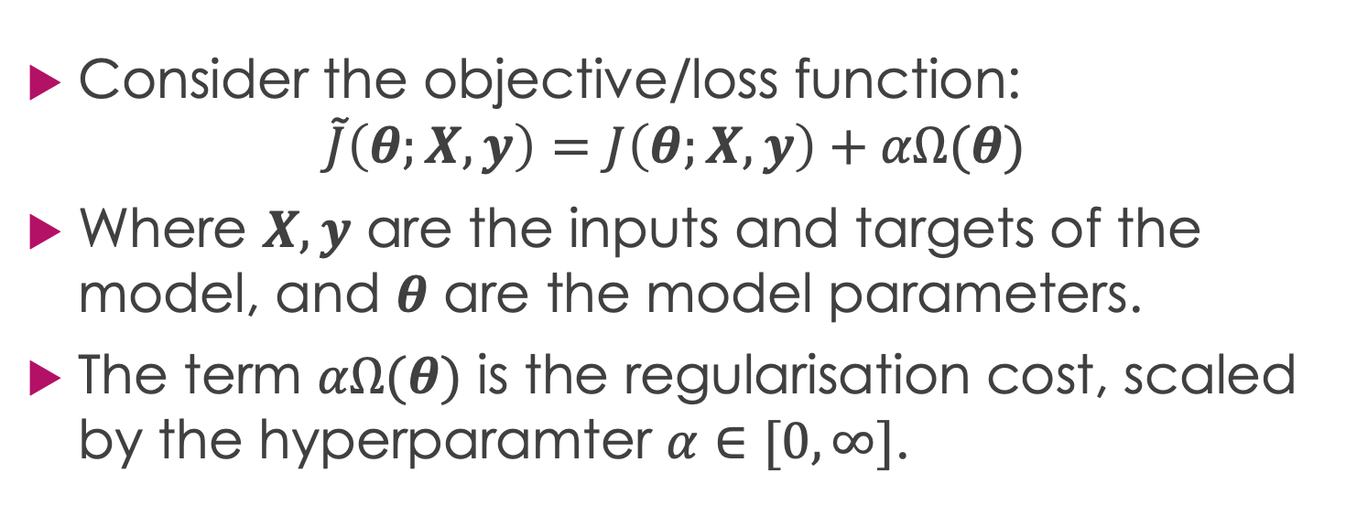
Parameter Penalties
Consider the objective/loss function:
$$\tilde{J}\left(θ;X,y\right)=J\left(θ;X,y\right)+αΩ(θ)$$
Where $X,y$ are the inputs and targets of the model, and $θ$ are the model parameters.
The term $αΩ(θ)$ is the regularisation cost, scaled by the hyperparamter $α∈[0,∞]$.

Slide 28
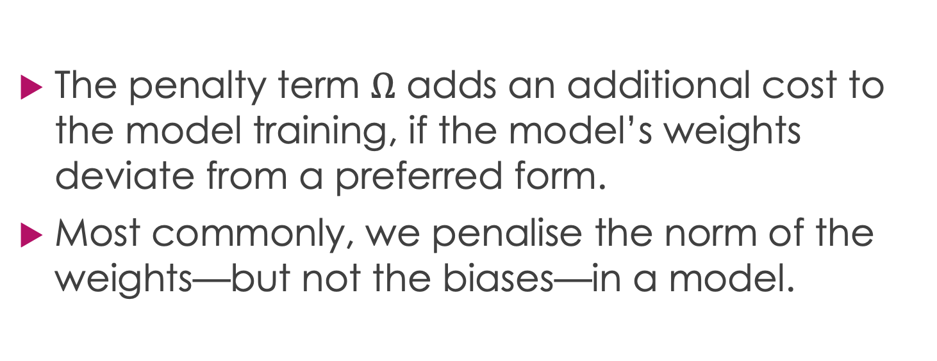
Parameter Penalties
The penalty term $Ω$ adds an additional cost to the model training, if the model’s weights deviate from a preferred form.
Most commonly, we penalise the norm of the weights—but not the biases—in a model.

Slide 29
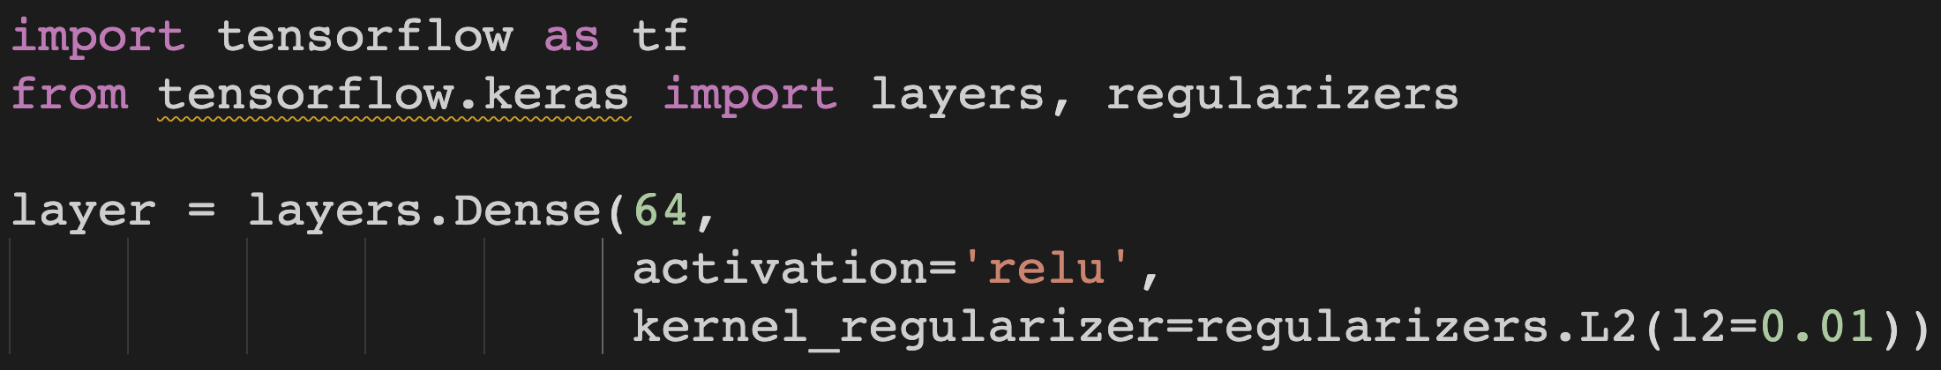
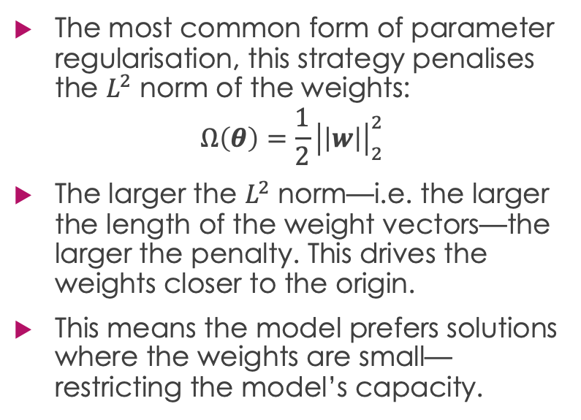
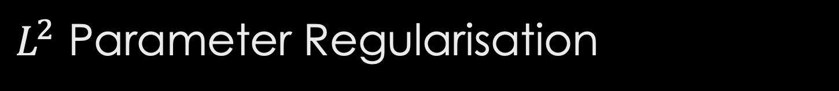
$L^{2}$ Parameter Regularisation
The most common form of parameter regularisation, this strategy penalises the $L^{2}$ norm of the weights:
$$Ω\left(θ\right)=\frac{1}{2}{\left|\left|w\right|\right|}_{2}^{2}$$
The larger the $L^{2}$ norm—i.e. the larger the length of the weight vectors—the larger the penalty. This drives the weights closer to the origin.
This means the model prefers solutions where the weights are small—restricting the model’s capacity.

Slide 30
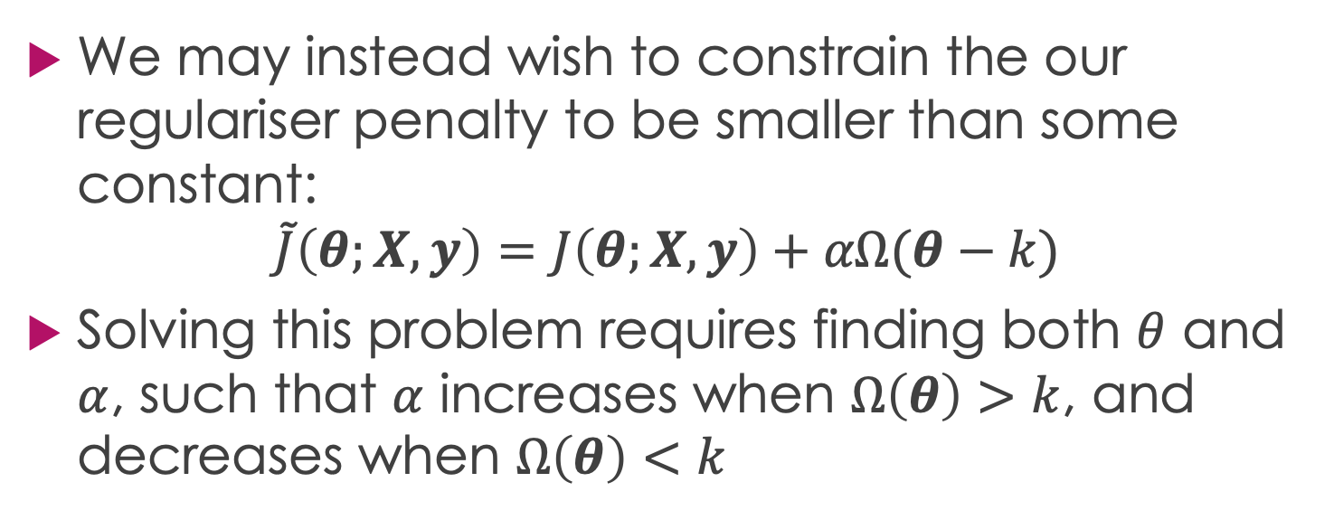
Parameter Constraints
We may instead wish to constrain the our regulariser penalty to be smaller than some constant:
$$\tilde{J}\left(θ;X,y\right)=J\left(θ;X,y\right)+αΩ(θ−k)$$
Solving this problem requires finding both $θ$ and $α$, such that $α$ increases when $Ω\left(θ\right)>k$, and decreases when $Ω\left(θ\right)<k$

Slide 31
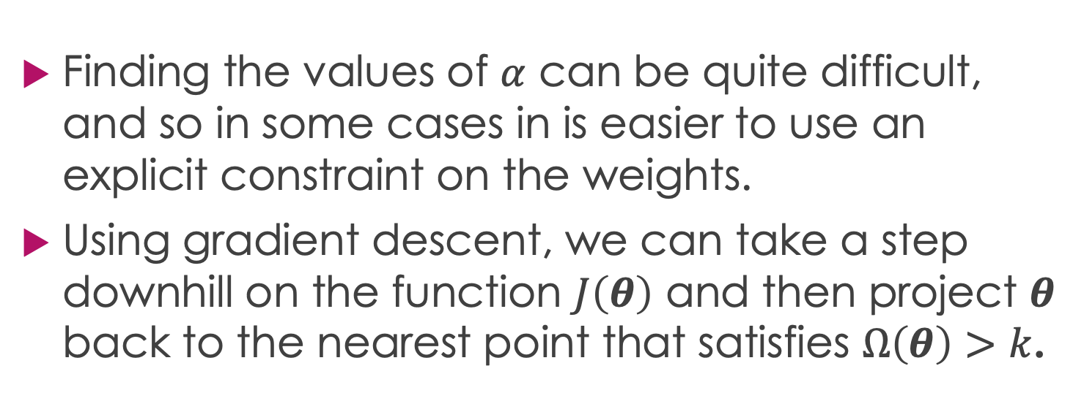
Explicit Constraints
Finding the values of $α$ can be quite difficult, and so in some cases in is easier to use an explicit constraint on the weights.
Using gradient descent, we can take a step downhill on the function $J\left(θ\right)$ and then project $θ$ back to the nearest point that satisfies $Ω\left(θ\right)>k$.

Slide 32
Dead Units
The benefit of using explicit constraints over weight decay, is that the latter can often induce “dead units” where the weights are arbitrarily small and do not contribute to the learned function.
Explicit constraints avoid this, because they do not encourage the weights to approach the origin, they merely stop them from growing too large.

Slide 33
Early Stopping
We often observe in overfitting models that the training loss continues to improve over time, while the test loss begins to rise after reaching a a certain value.
This means we can obtain a more optimised model by taking the parameters at the point where the test loss stopped improving.

Slide 34
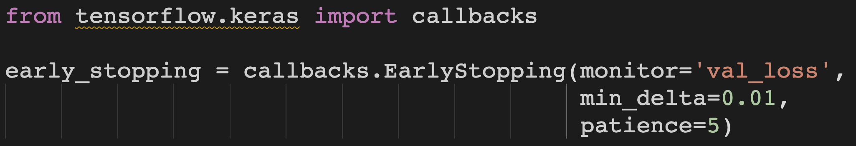
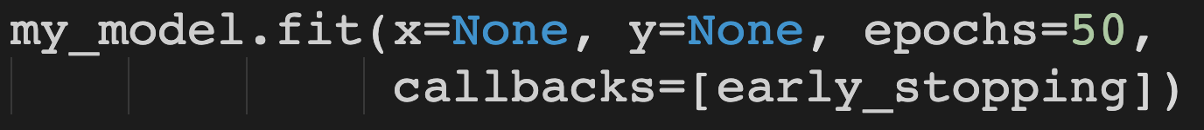
Early Stopping Callback

Slide 35
Dropout
Dropout is a powerful, yet inexpensive, form of regularisation—put simply, Dropout allows you to train a large ensemble of submodels simultaneously.
Each subnetwork in a model is created by removing the output of certain nodes in the base network—such as by setting their activations to zero.

Slide 36
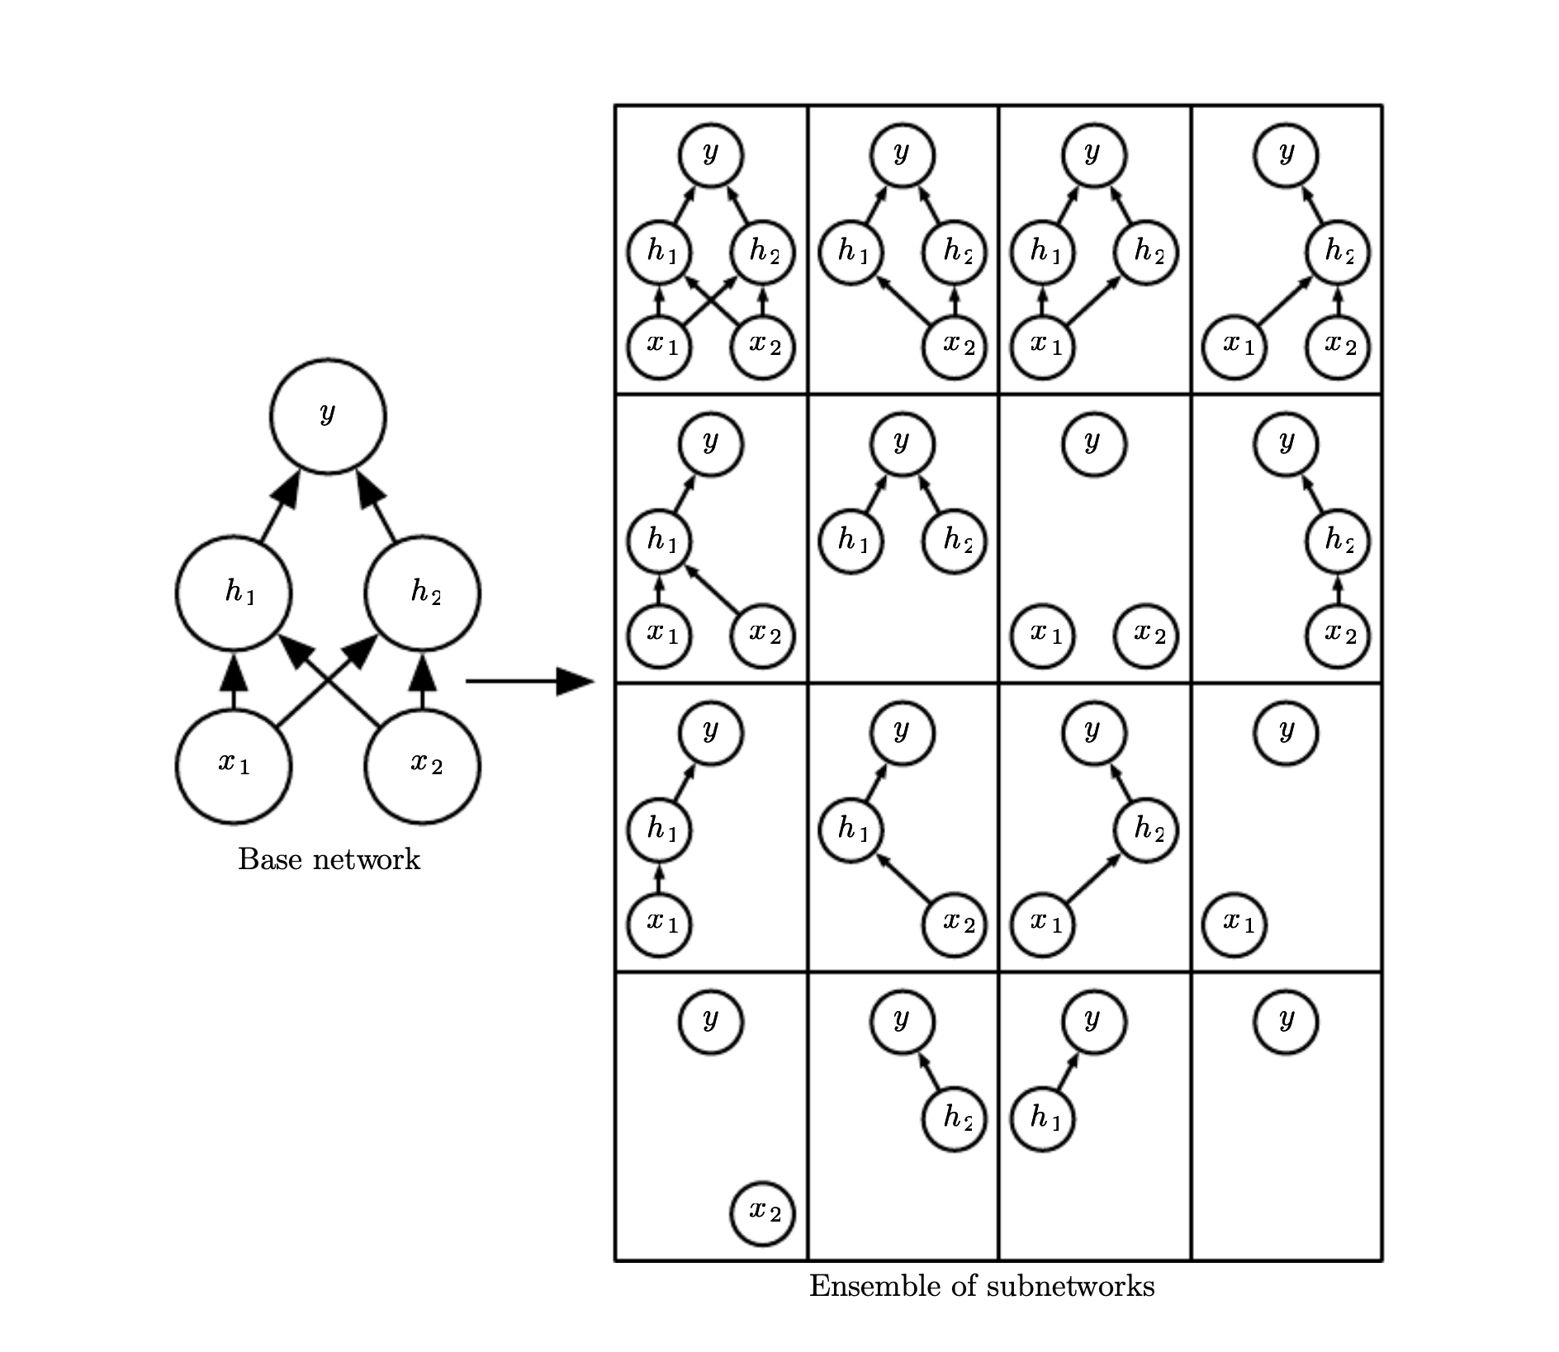
Dropout
Dropout works with a network trained in batches—each time a batch is created, a random selection of neurons in the network are “switched off”.
Each subnetwork has a subset of the parameters that it inherits from the parent network and are shared with other subnetworks.
The dropout rate is a hyperparameter selected for each layer—this is usually 0.5 for Dense layers, and 0.1-0.2 for Convolutional layers.
Chapter 7, Deep Learning Book

Slide 37
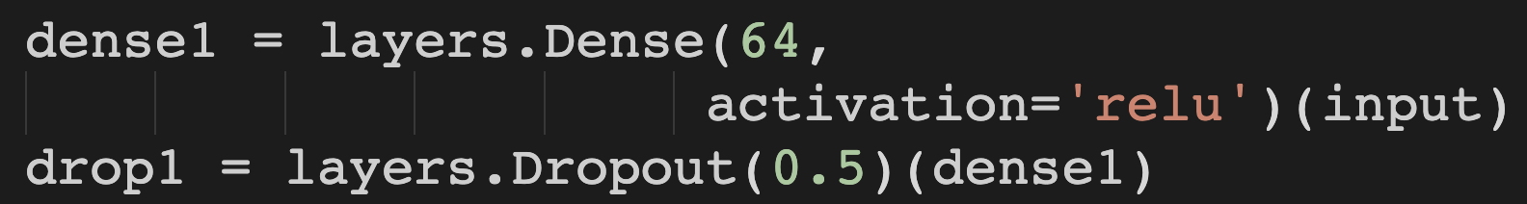
Dropout in Tensorflow

Slide 38
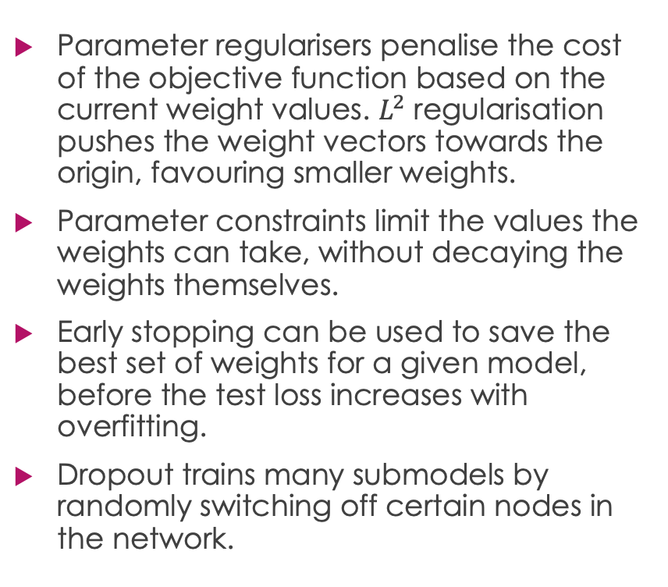
Review
Parameter regularisers penalise the cost of the objective function based on the current weight values. $L^{2}$ regularisation pushes the weight vectors towards the origin, favouring smaller weights.
Parameter constraints limit the values the weights can take, without decaying the weights themselves.
Early stopping can be used to save the best set of weights for a given model, before the test loss increases with overfitting.
Dropout trains many submodels by randomly switching off certain nodes in the network.
Regularisation is any method that alters the behaviour of a model in order to improve its generalising abilities.

Slide 39
Questions???

